Slide 1

People’s Postcode Lottery
Accessibility Audit
May 2019

Slide 2


Contents
Importance of Accessible Design
Persona Analysis
Web Content Accessibility Guidelines
WAVE Web Accessibility Evaluation
Summary

Slide 3
Importance of Accessible Design

Slide 4

Importance of Accessible Design
The internet is an increasingly important resource in our lives – with education, employment, political, health care and recreational activities now regularly covered online
The UK has an estimated population of 67 million as of 2019, with more than 20% of that number disabled or impaired*
Accessible design ensures your website provides equal access and equal opportunity to all users,
* Source: https://www.scope.org.uk/media/disability-facts-figures

Slide 5
Importance of Accessible Design
Although ensuring disabled or impaired users can use your site is a key area, true accessibility is about putting all of your users first
There are online tools that can help evaluate the accessibility of content, but they cannot take into account other individual factors to judge the overall user experience
Only a human can determine true accessibility
* Source: https://www.scope.org.uk/media/disability-facts-figures
Notes:
Sticking to web standard and future proofing your website

Slide 6
Persona Analysis

Slide 7
Disability and Impairment Personas
In 2017 the UK Government Digital Services team (GDS) introduced accessibility personas - highlighting common barriers which should be taken into account when designing websites.
These personas cover:
Partial sightedness
Colour blindness
Rheumatoid arthritis
Cognitive impairments
Older users with multiple conditions
Source: https://www.gov.uk/government/publications/understanding-disabilities-and-impairments-user-profiles

Slide 8
Persona Analysis Partial Sightedness

Slide 9

Partial Sightedness What It Means
An estimated 4% of users have a visual impairment, with 60% wearing glasses or contact lenses
Clearly structured content with clear contrasting colour schemes should be used, to ensure a site is as straightforward to understand as possible.
Users may use screen readers or magnifiers to aid navigation and interaction – so all site content, including forms and error messages, should be compatible.

Slide 10
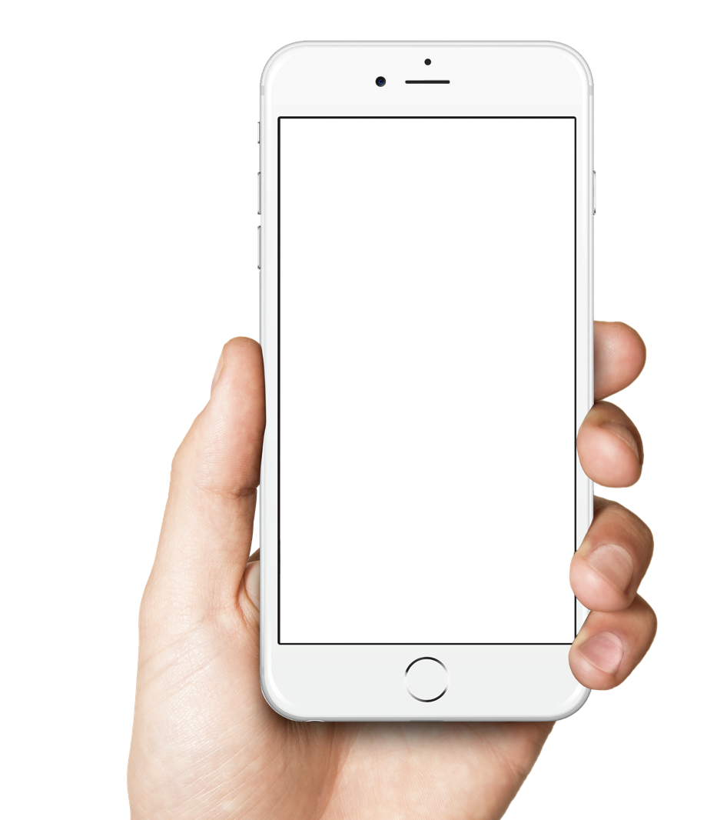
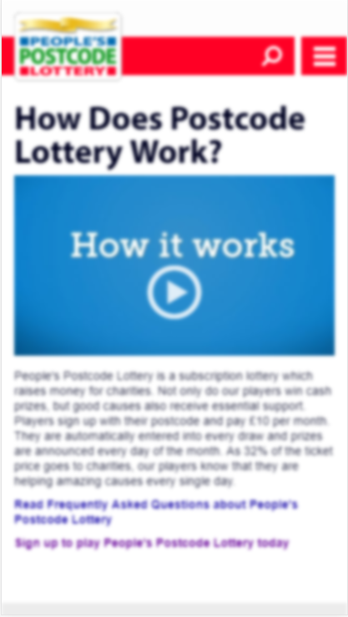
Partial Sightedness Site Performance
Homepage / How It Works Page
Block text and title content remained largely coherent, but navigation and CTA text quickly became tricky to read, with the white text blurring into the red background.
Video iconography was clear to identify and use, but a lot of the standard font content quickly became difficult to read – especially on the ‘How It Works’ page.
However the page did allow users to zoom and adjust text size, which could aid comprehension.

Slide 11

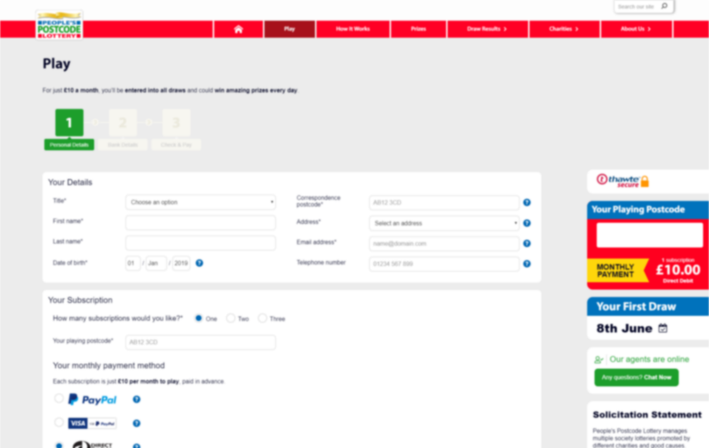
Partial Sightedness Site Performance
Play Page
The three steps of the play page remain fairly clear to make out and follow.
Form titles largely follow best practice guidelines and remain readable, but the light colouring of field text means it quickly becomes illegible. Error messages were also difficult to interpret, with the white text blurring into the red background.

Slide 12
Persona Analysis Colour Blindness

Slide 13

Colour Blindness What It Means
Around 4.5% of users (8% of men and 0.5% of women) have a form of colour vision deficiency – more commonly known as colour blindness
Deficiencies can relate to not seeing colours clearly, getting colours mixed up or not being able to differentiate between certain colours.
These issues can often be intensified by the environments in which people often use websites - such low-quality monitors, bad lighting, screen glare or smaller mobile screens.
Content should never rely on colour for readability – for example to distinguish product attributes or text which is a hyperlink

Slide 14
Colour Blindness What It Means
To ensure your site remains as accessible as possible, it is recommended to avoid the following colour combinations in close proximity:
Appearance to colour blind user:
Appearance to colour blind user:
Green / Red
Green / Yellow
Green / Brown
Blue / Grey
Blue / Purple
Green / Grey
Green / Blue
Green / Black

Slide 15
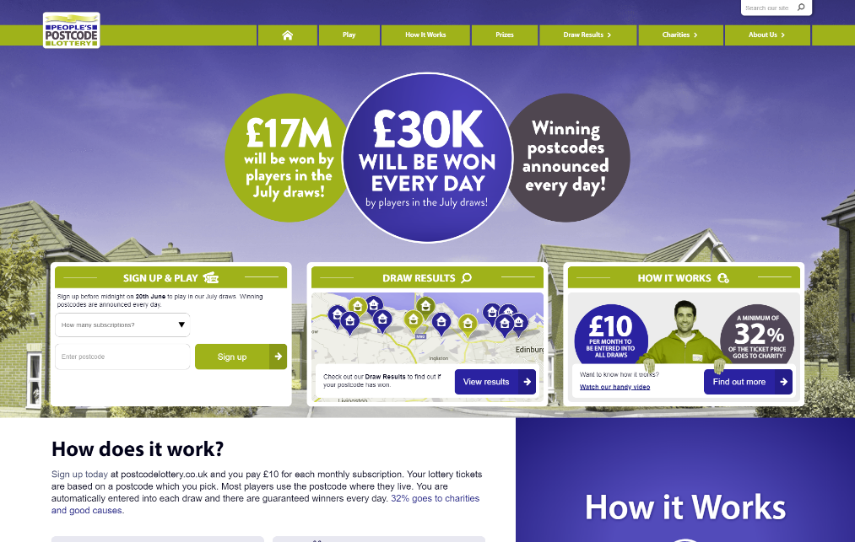
Colour Blindness Site Performance
Homepage
There are minimal issues that should arise through colour blindness.
The only conflicting use of colours occurs within the logo, but this is unlikely to negatively affect user experience or conversion.
Users may struggle to identify between the differing coloured markers as part of the Draw Results map – this again would be unlikely to create major issues with conversion, but for full accessibility accordance we would recommend reviewing the colour scheme used here.

Slide 16
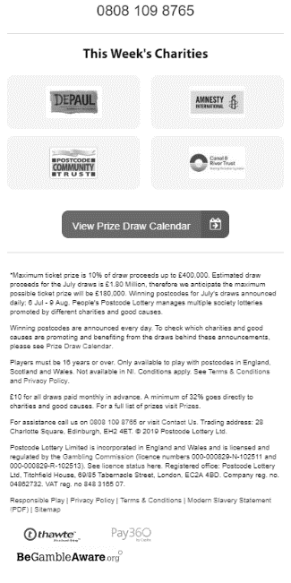
Colour Blindness Site Performance
How It Works
Likewise the colour scheme for the ‘How It Works’ page content, is unlikely to cause many issues to users.
One exception however relates to the footer text, where important hyperlinks including contact details, terms and conditions and privacy policy are located.
The text relies on colour to communicate the words which are links, with no additional formatting provided. This would likely cause issues for users with colour blindness such as achromatopsia – a condition causing all vision to appear in greyscale (affecting approx. 1 in 30,000 people).
We recommend using clear styling differences to differentiate hyperlinks from surrounding text, such as underlining.

Slide 17

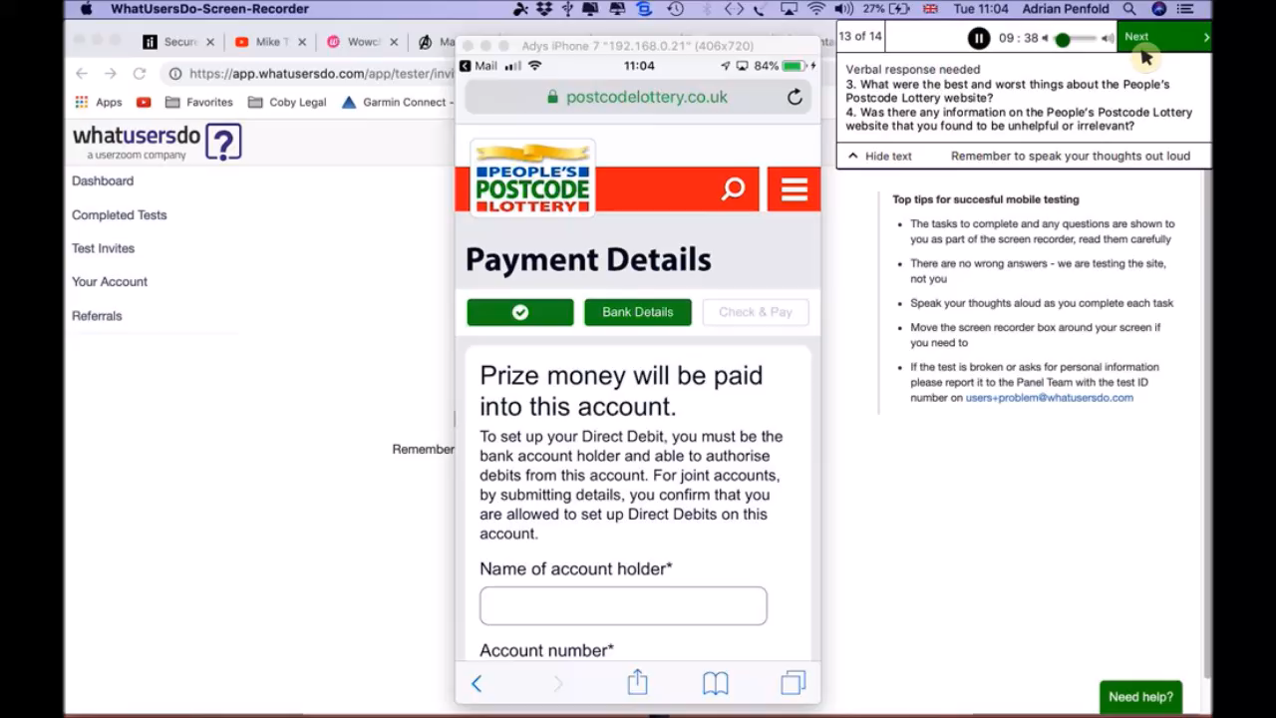
Colour Blindness Site Performance
Video
Play Page
In user testing, users reported minimal issues in engaging with the Play page and completing the form.
Again the use of colours within the page build are unlikely to cause many serious issues relating to user experience or conversion. However there are further uses of hyperlinks which are only communicated to the user through colour – such as the ‘Edit your Personal Details’ and ‘Edit your Bank Details’ links when the user reaches the third stage of the Play page.
We recommend using clear styling differences to differentiate hyperlinks from surrounding text, such as underlining.

Slide 18
Persona Analysis Rheumatoid Arthritis

Slide 19

Rheumatoid Arthritis What It Means
About 12% of the population have some form of hand motor impairment, potentially impairing their control of a mouse
Sites should be designed to work for users who are unable to or prefer not to use a mouse or trackpad. Additional steps can be taken to aid users who browse in this manner – such as removing time limits on forms or including features which minimise text entry (like address lookups)

Slide 20
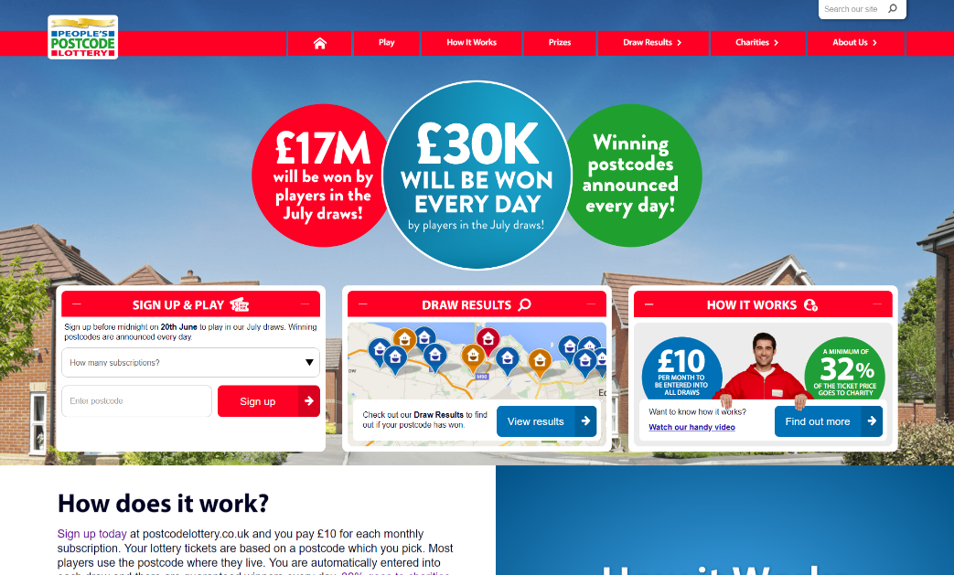
Rheumatoid Arthritis Site Performance
Homepage / How It Works
Both the Homepage and How It Works page contain multiple links, which although take some time to reach are all accessible when navigating solely via a keyboard.
Although most elements maintain an obvious keyboard focus, some could be made clearer to aid users who navigate the site in this way – for example clearer outlining of the ‘How It Works’ video link.

Slide 21
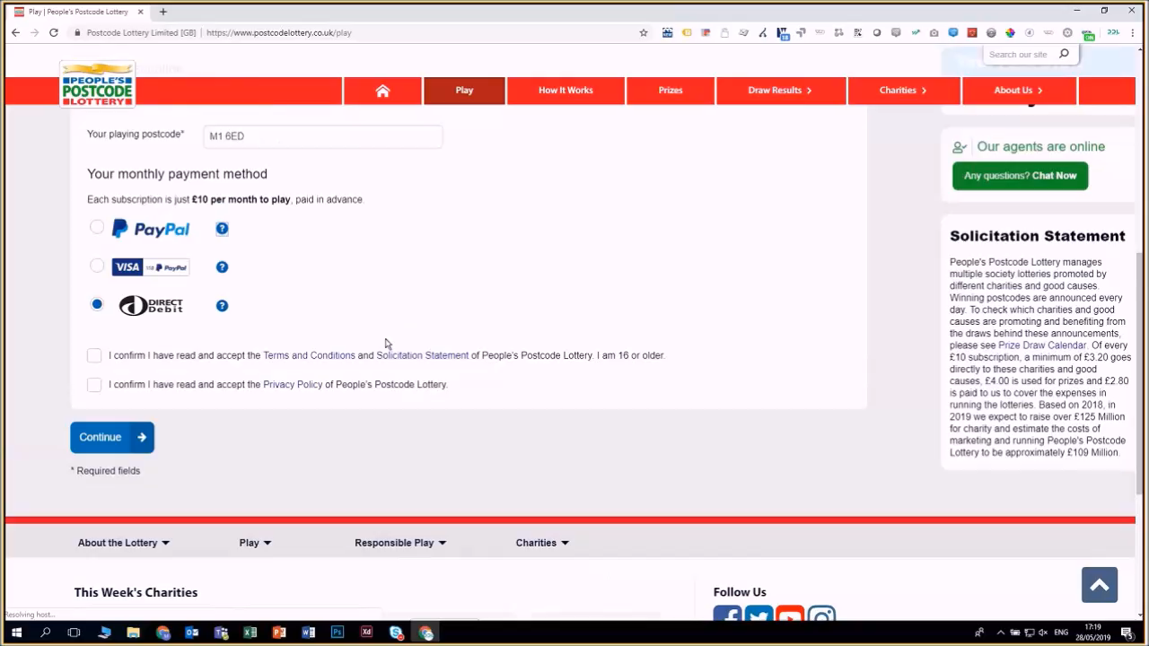
Rheumatoid Arthritis Site Performance
Video
Play Page
During testing, several elements on the Play Page appeared tricky to select for users with limited mouse control – perhaps due to some kind of motor impairment.
We found it difficult to select radio buttons and struggled to close the chat overlay that appeared without prompt. However the use of hover to trigger the help icons (as opposed to clicking) was a positive.

Slide 22
Persona Analysis Cognitive Impairment

Slide 23

Cognitive Impairment What It Means
Around 10% of users are estimated to have a kind of cognitive impairment, with a further 10% estimated to have a reading impairment such as dyslexia
Sites should avoid bright colours or big, distracting animations. Content should be written in plain English and clearly separated into headers and paragraphs, with the most important content located toward the top of the page. Providing captions for any video content is also recommended

Slide 24
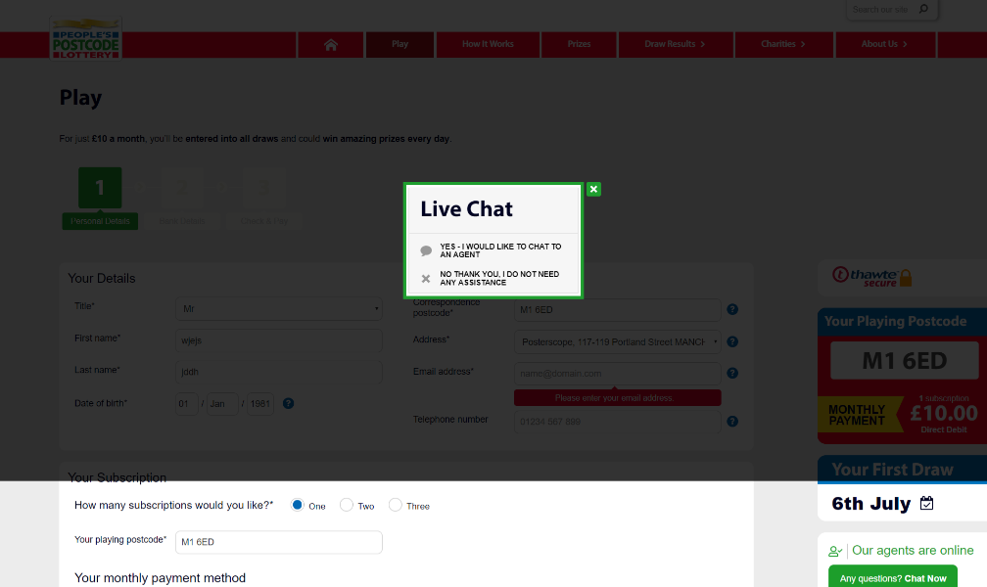
Cognitive Impairment Site Performance
All Pages
The site is generally free of distractions – although the chat overlay suddenly appearing without prompt could prove disruptive to users with a cognitive impairment.
Video content also contains automatic subtitles, which are an excellent way of ensuring users can engage with video content in multiple settings – especially those who may find sudden volume overwhelming.

Slide 25
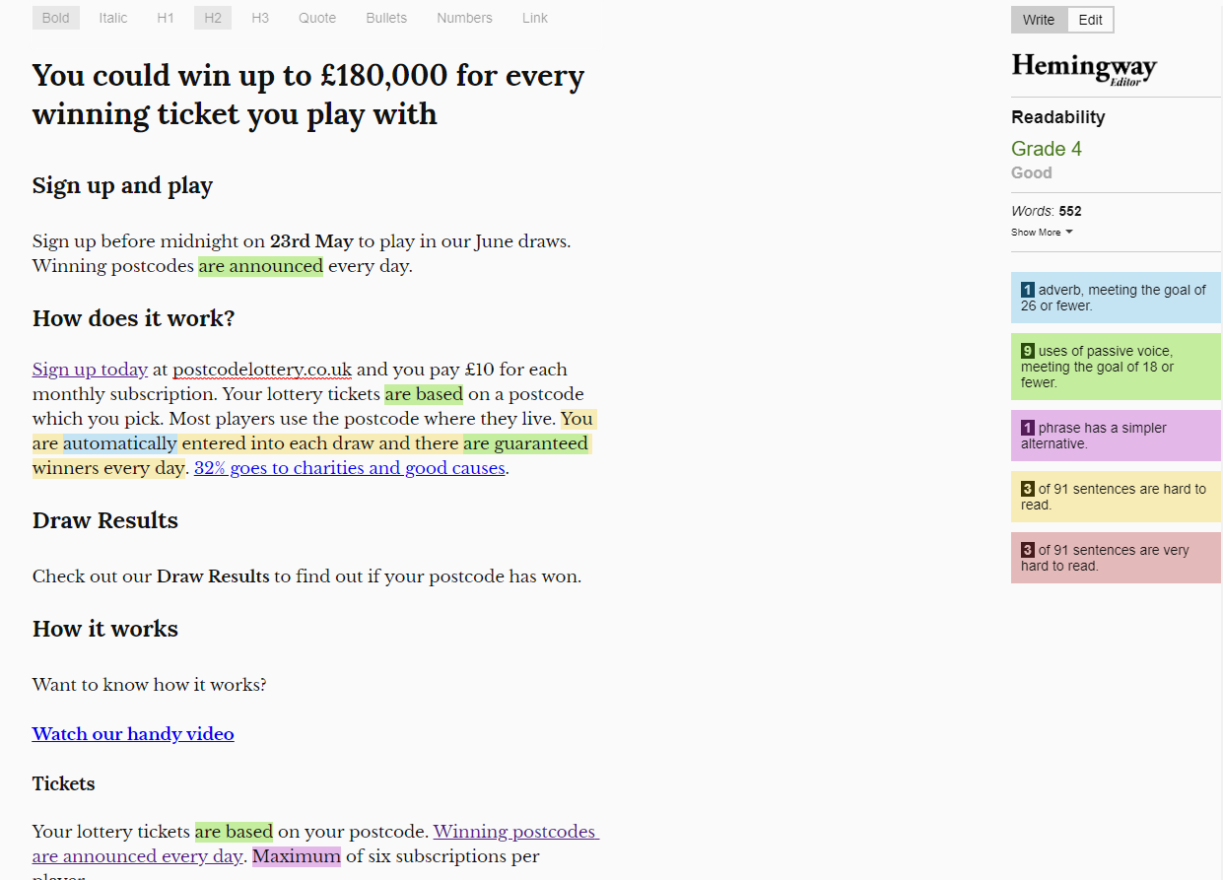
Cognitive Impairment Site Performance
All Pages
A Hemingway Grade highlights readability of content, with the grade relating to high school year that the content is suitable for. Higher scores are therefore given for lengthy, complex sentences. Any score less than 9 is considered excellent.
Pages across the site regularly scored Grade 5, highlighting the site is generally well written and simple to understand.
One exception was the Solicitation Statement which scored Grade 10, however this is unlikely to affect conversion.
Review taken from: http://www.hemingwayapp.com/

Slide 26
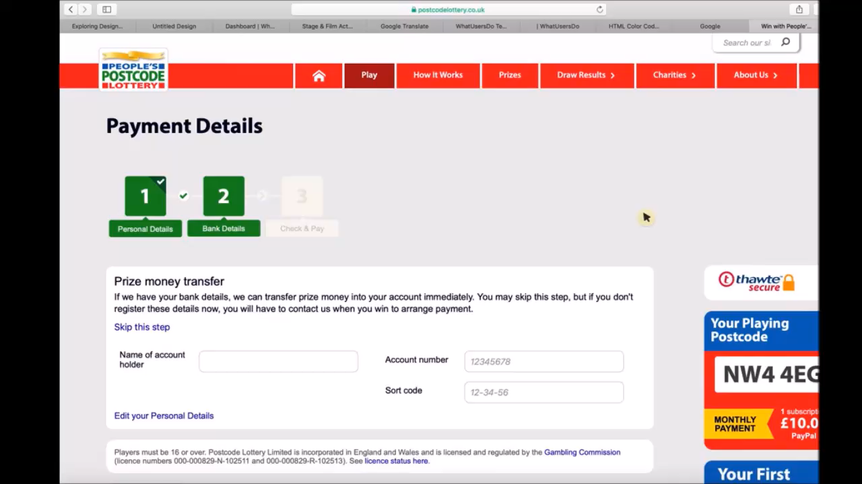
Cognitive Impairment Site Performance
Video
All Pages
In our user testing, users with cognitive impairments appeared to struggle with the amount of numerical content used, especially in trying to understand the different prizes on offer during a monthly subscription.
During our moderated research we discovered a similar effect, which may have been magnified in this particular case. We would recommend reviewing the way this content is presented to try and make it slightly more concise and readable.

Slide 27
Persona Analysis Older Users

Slide 28

Older Users What It Means
Over 11 million people in the UK are deaf or hard of hearing and by 2030 it is estimated that 22% of UK web users will be 65 or over
Offline sections of sites should be accessible and content written in plain English - again clearly separated into headers and paragraphs, with the most important content located toward the top of the page.
Fonts should be presented in a good colour contrast and any forms clearly laid out – with adequate spacings between fields and labels

Slide 29
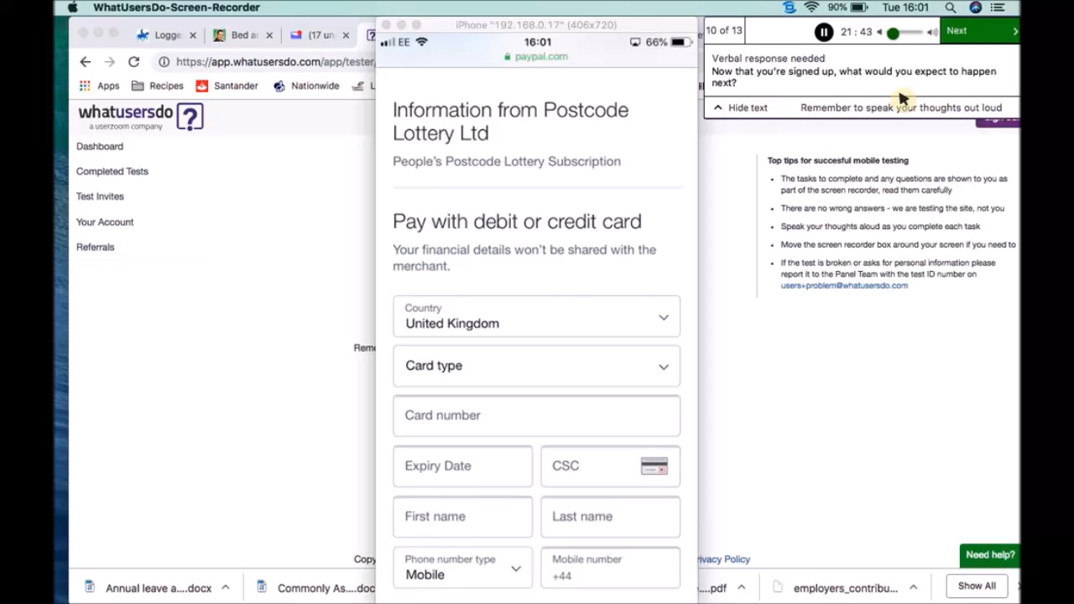
Older Users Site Performance
Video
Landing Page / How It Works
In our user testing, older users appeared to struggle with the default size of the text used on the site being described as too small.
Additionally users felt the logo used on the site was rather small which made brand recognition difficult – with struggles especially witnessed in relating the Landing Page to the rest of the website or locating a menu or search bar to be able to browse further.
Text size can be edited within the browser, with the site also compatible with screen magnifiers. As per previous findings, video content contains clear and automatic subtitles and content was graded as easy to read.
Notes:
CTA sizes

Slide 30
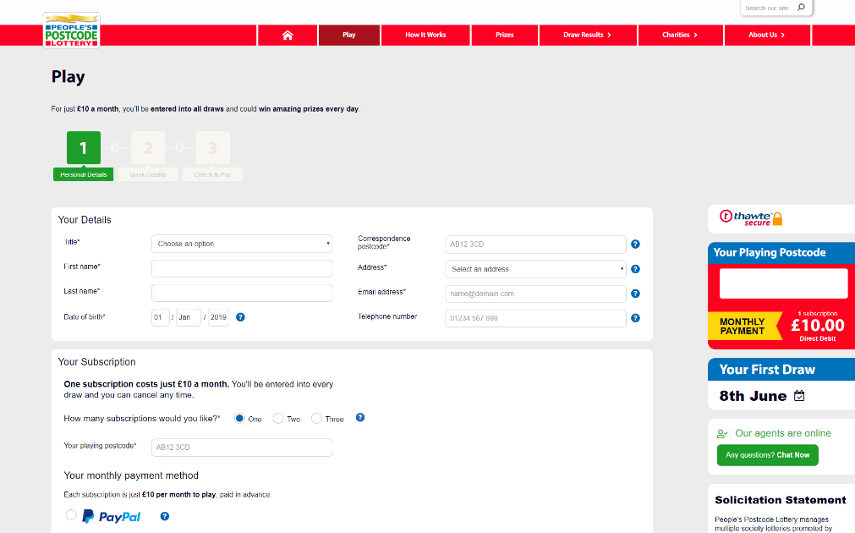
Older Users Site Performance
Play Page
Contact details are clearly provided throughout the site, with both a contact number and social media links clearly provided within the footer.
Live chat is promoted on the desktop page on the right hand sidebar, but does not appear to be clearly offered on mobile or tablet devices. Additionally it does not appear to be prominently available on any devices outside of the Play Page.

Slide 31
Web Content Accessibility Guidelines

Slide 32
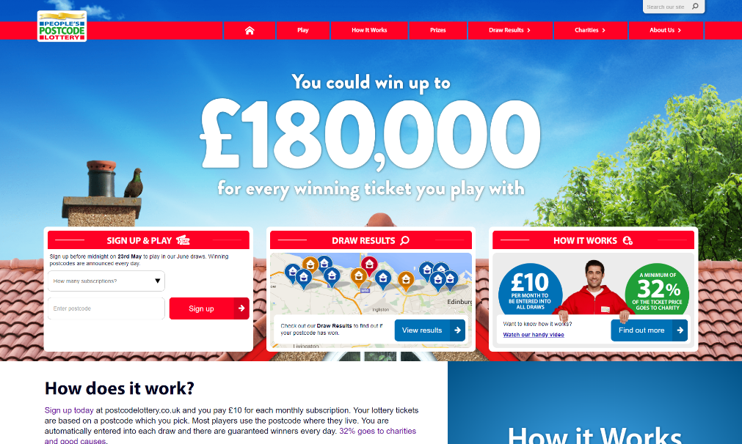
Web Content Accessibility Guidelines Homepage / How It Works / Play Page
Passed with 2 issues
WCAG 2.0 (Level AA)
Web Content Accessibility Guidelines (WCAG) are developed through the W3C process in cooperation with individuals and organizations around the world, with a goal of providing a
single shared standard for web content accessibility that meets the needs of individuals, organizations, and governments internationally.
Review taken using official tool: https://achecker.ca/checker/index.php

Slide 33
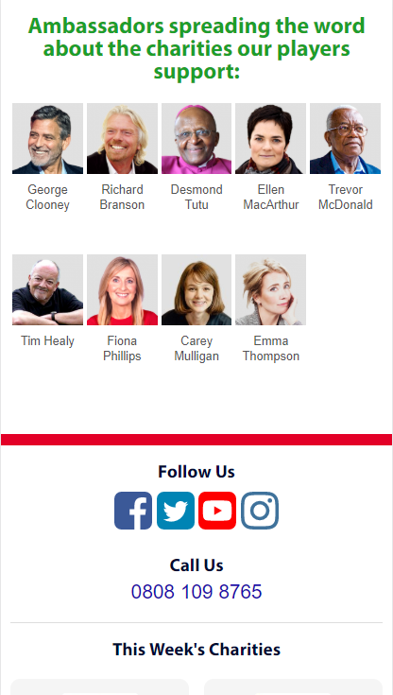
Web Content Accessibility Guidelines Homepage / How It Works / Play Page
Issue 1
Header nesting - header following <h2> is incorrect
Why it matters
Many tools such as screen readers rely on HTML syntax guidelines to help users navigate, find content, and determine where they are
How to fix
Modify header levels so only <h3> or any header less than <h3> follows <h2>
Review taken using official tool: https://achecker.ca/checker/index.php
Notes:
Homepage: Line 3641, Column 13:<h2>Ambassadors spreading the word about the charities our players support:</h2>(tickets)
How It Works: Line 297, Column 7:<h2 class="how-it-works-cta__heading">Sign up before midnight on 23rd May to play in our June draws. ...(draws)
Play Page: Line 263, Column 9:<h2 class="webchat-popup__heading">Live Chat</h2>

Slide 34
Web Content Accessibility Guidelines Homepage / How It Works / Play Page
Issue 2
id attribute is not unique
Why it matters
Code and page content should be robust enough that it can be interpreted reliably by a wide variety of user agents, including current and potential future assistive technologies. Including two attribute values with matching id values could cause issues with JavaScript and jQuery libraries not functioning correctly
How to fix
Modify the id attribute value so it is unique, ensuring all future id attribute values are kept unique
Review taken using official tool: https://achecker.ca/checker/index.php
Notes:
Line 1442, Column 1:<body class="container_12 home "> <noscript><iframe src="//www.googletagmanager.com/ns.html? ...(tickets)

Slide 35
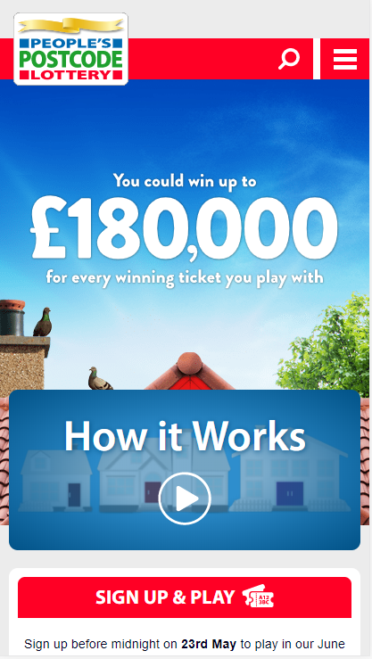
Web Content Accessibility Guidelines Homepage
Other Potential Issues
Image Alt text may be too long
Why it matters
Alt text should describe content as concisely as possible. Longer alt text will result in a lengthy screen reader description, providing a frustrating user experience
How to fix
Images requiring a lengthier description should be described within the page content, rather than the alt text. If Alt text is greater than 100 characters then it should be shortened if possible
Review taken using official tool: https://achecker.ca/checker/index.php
Notes:
Line 4332, Column 108:<img alt="Funding from players has helped play a crucial role in supporting Friends of the Earth fig ... Line 4372, Column 107:<img alt="Broadcaster, farmer and ex-JLS member JB Gill travelled to Zimbabwe to see the lifesaving ...

Slide 36
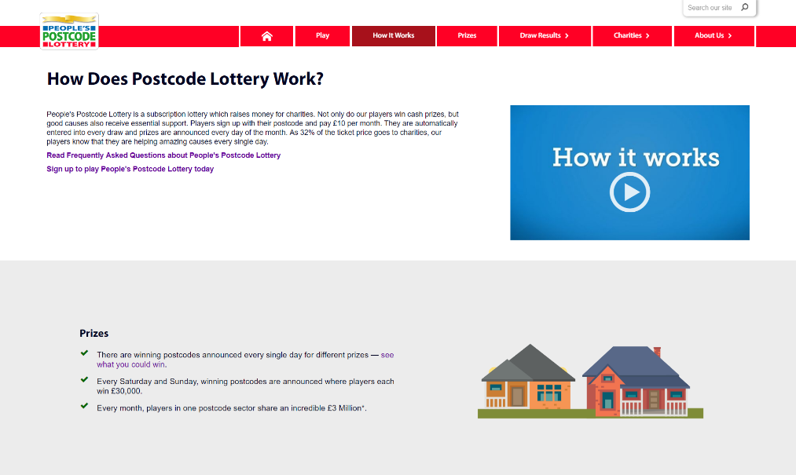
Web Content Accessibility Guidelines How It Works
Other Potential Issues
‘p’ element may be misused (could be a header)
Why it matters
Many tools such as screen readers rely on HTML syntax guidelines to help users navigate, find content, and determine where they are. Correctly formatted headings can save all users a lot of time and frustration, especially those using screen readers.
How to fix
Ensure ‘p’ elements are not stylised with italics, bolded or given an increased font size to give the appearance of headings.
Review taken using official tool: https://achecker.ca/checker/index.php
Notes:
Line 288, Column 1:<p><strong><a data-linkcontent-id="21" data-linkcontent-title="Frequently Asked Questions (FAQ)" dat ...
Line 290, Column 1:<p><strong><a data-linkcontent-id="41" data-linkcontent-title="Play" data-linkcontent-type="page" da ...

Slide 37
WAVE - Web Accessibility Evaluation Tool

Slide 38

Web Content Accessibility Guidelines Homepage / How It Works / Play Page
Passed with 2 errors
WAVE Web Accessibility Evaluation
WAVE is an automated testing tool, designed to help analyse websites for accessible content and design.
Tools such as this are useful for facilitating human evaluation and providing further education around accessibility issues – but results must always be interpreted as part of a larger picture.
WAVE itself cannot provide a straight forward answer as to whether a site and it’s content is accessible or not - only a human can determine true accessibility.
Review taken using WAVE official tool: http://wave.webaim.org/report#/https://www.postcodelottery.co.uk/

Slide 39
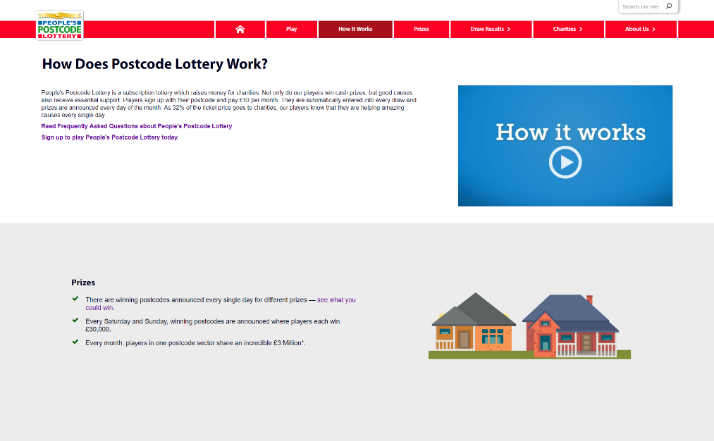
Web Content Accessibility Guidelines Homepage / How It Works / Play Page
Issue 1
Empty Button on Search Bar
Why it matters
When navigating to a button, descriptive text must be presented to screen reader users to indicate the function of the button
How to fix
Place text content within the <button> element or give the <input> element a value attribute
Review taken using WAVE official tool: http://wave.webaim.org/report#/https://www.postcodelottery.co.uk/how-it-works

Slide 40
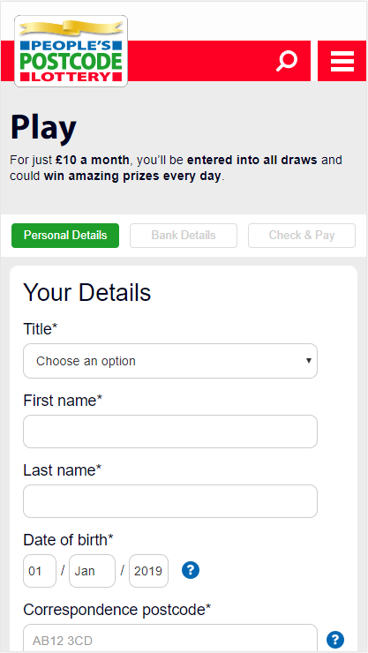
Web Content Accessibility Guidelines Play Page
Issue 2
Form labels missing
Why it matters
If a form does not have a properly associated text label, purpose of that form may not be presented to screen reader users. Form labels also provide visible descriptions and larger
clickable targets
How to fix
If a text label for a form control is visible, use the <label> element to associate it with its respective form control. If there
is no visible label, either provide an associated label, add a descriptive title attribute to the form control, or reference the label(s) using aria-labelledby
Review taken using WAVE official tool: http://wave.webaim.org/report#/https://www.postcodelottery.co.uk/play

Slide 41
Summary

Slide 42

Summary Recommendations
Consider enlarging default site font size
Review formatting of example field text and error messaging
Review colour scheme of markers used on Winners Map
Apply clear styling differences to differentiate hyperlinks from surrounding text
Apply clear outlining to elements when tabbed to using a keyboard
Consider increasing hit area of radio buttons
Simplify formatting of monthly prize listings
Addition of live chat functionality to all areas of site and across all devices
Increase size of Live Chat overlay close icon / allow clicking outside element to close

Slide 43
Summary Recommendations
Modify header levels so only <h3> or any header less than <h3> follows <h2>
Modify the id attribute value so it is unique, ensuring all future id attribute values are kept unique
If image ‘alt’ text is greater than 100 characters, review if more concise copy is possible
Ensure <p> elements are not stylised with italics, bolded or given an increased font size to give the appearance of headings
Place text content within the <button> search icon element or give the <input> element a value attribute
Add form labels to Play Page fields

Slide 44
Thank You

